Slide 1
Growth Mindset
10.17.2016

Slide 2
Get into groups of 3
Create a chart like the one below (leave enough room to add on to your chart later)
Label the left hand side “Things that are HARD”
Label the right hand side “What I say when I’m doing these things”
Things that are HARD | What I say when I’m doing these things
Trying to find the right college | “I’m never going to find the right fit”
Tryouts for the spring musical | “This is TOO much!”

Slide 3
Each member of the group needs to record at least two things to the chart that are personally hard for them
As a group determine what might be some thoughts that go through our minds about the task we are trying to complete, fill in the chart
Things that are HARD | What I say when I’m doing these things
Trying to find the right college | “I’m never going to find the right fit”
Tryouts for the spring musical | “This is TOO much!”

Slide 4
Go to the following website and play the Star Wars Video
http://www.stepitup2thrive.org/mindset/group-lessons/mindset-lesson-one/

Slide 5
Discussion Questions
What was Yoda asking Luke to do?
What words did Luke say to Yoda?
What did Yoda say to Luke?
Who had a growth mindset and who had a fixed mindset?

Slide 6
Completing the Chart
Go back to your chart and add another column titled “Be Like YODA”
Things that are HARD | What I say when I’m doing these things | Be Like YODA
Trying to find the right college | “I’m never going to find the right fit.” | “It will be so worth it when I find the right college.”
Tryouts for the spring musical | “This is TOO much!” | “My hard work will payoff on opening night!”

Slide 7
GROWTH
MINDSET
Episode XI:
Polar Bear Hope
Far, far away
in a land called
Des Moines was the
rebel force called
Polar Bear Crew!

Slide 8
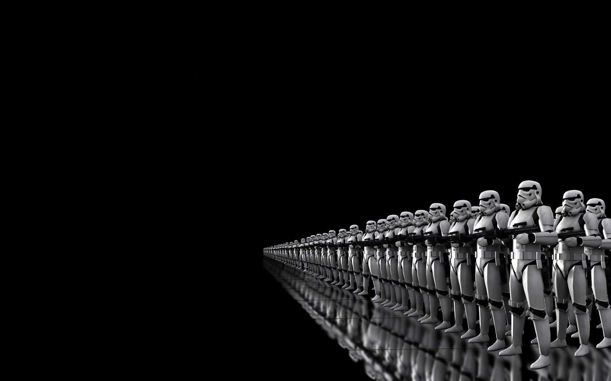
It’s dangerous to go “solo” but this force needs “wookies” that are firm but really care about NHS!

Slide 9
This students need to be fierce in the face of danger and attack.

Slide 10
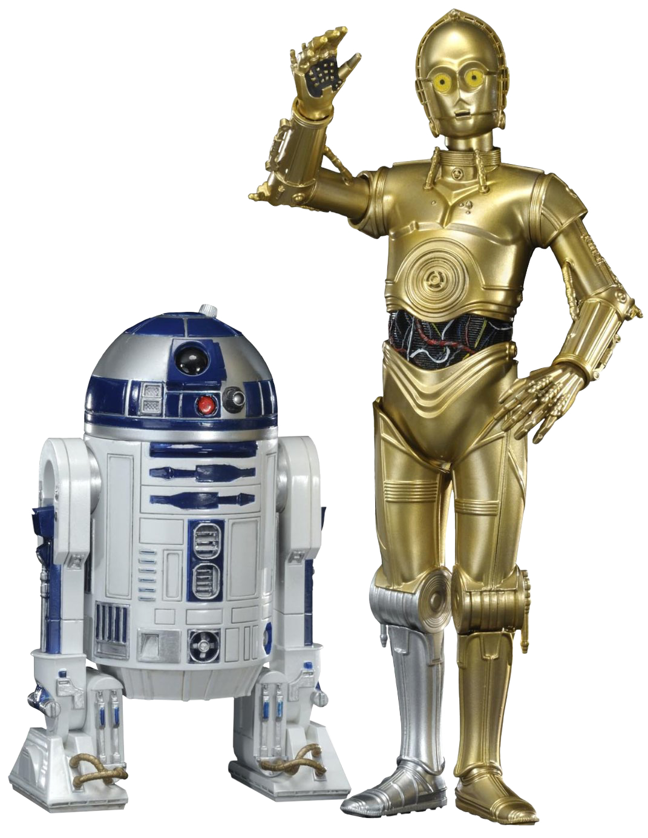
They need to be friendly and greet everyone with a smile and a wave.

Slide 11
And in the face of conflict they have to be valiant, courageous and brave!

Slide 12
These Students are the Polar Bear force in every way

Slide 13
“The force is strong with the Polar Bear Crew!”

Slide 14
The Polar Bear Crew will be coming to freshmen skinny classes tomorrow to facilitate a team building activity around growth mindset!

